Slide 1
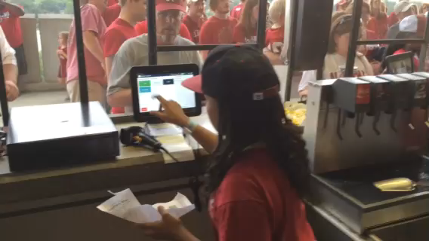
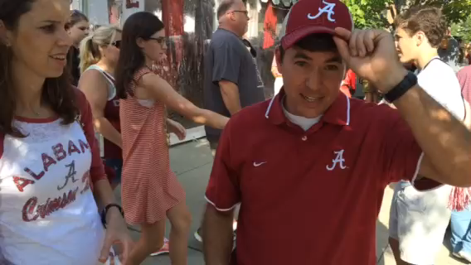
Alabama 2014 FB Loaded Ticket Program
- 11,000 FB VT Tickets Sold Up 91% Since 2013
40% Increase in Credit Card Transactions
20% Increase in Merchandise Sold

Slide 2
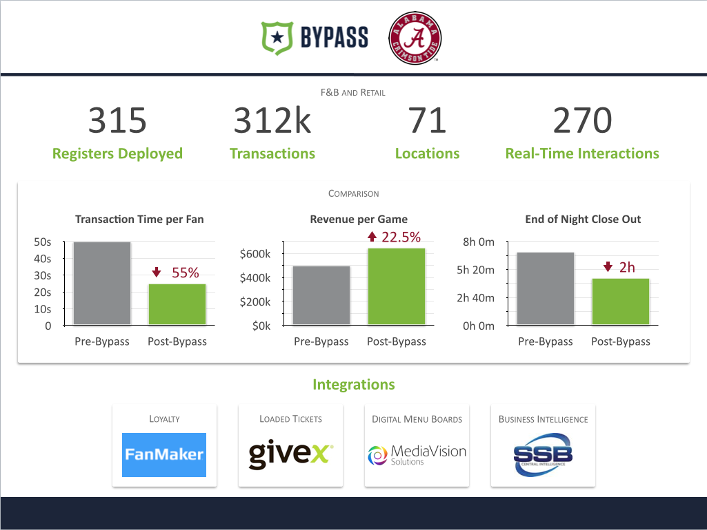
Bypass Mobile POS Deployment

